Slide 1
What do I use R for?
tidyr
lubridate
Dani Navarro
tidyverse
(dplyr)
magrittr
data cleaning
r, p, q, d
psych
car
apply, etc
(lme)
boot
statistics
programming
cognitive models
BayesFactor
JAGS (& Stan)
(rtdist)
optim
data visualisation
other
imager
art
base graphics
(leaflet)
(Shiny)
blogdown
ggplot
publications
teaching!

Slide 2
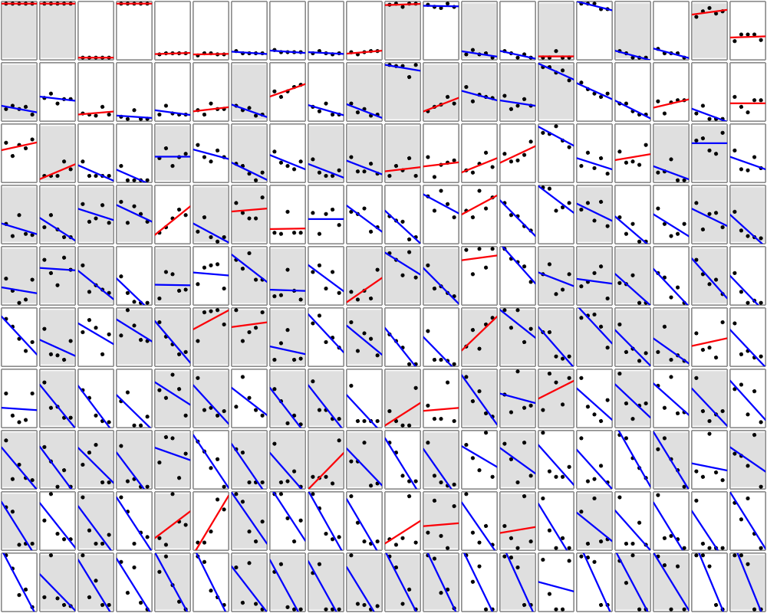
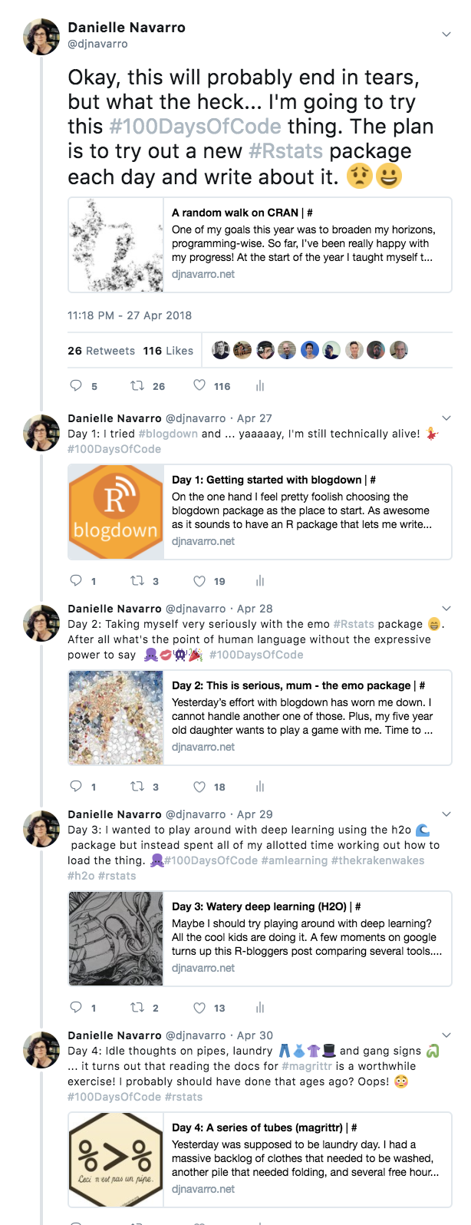
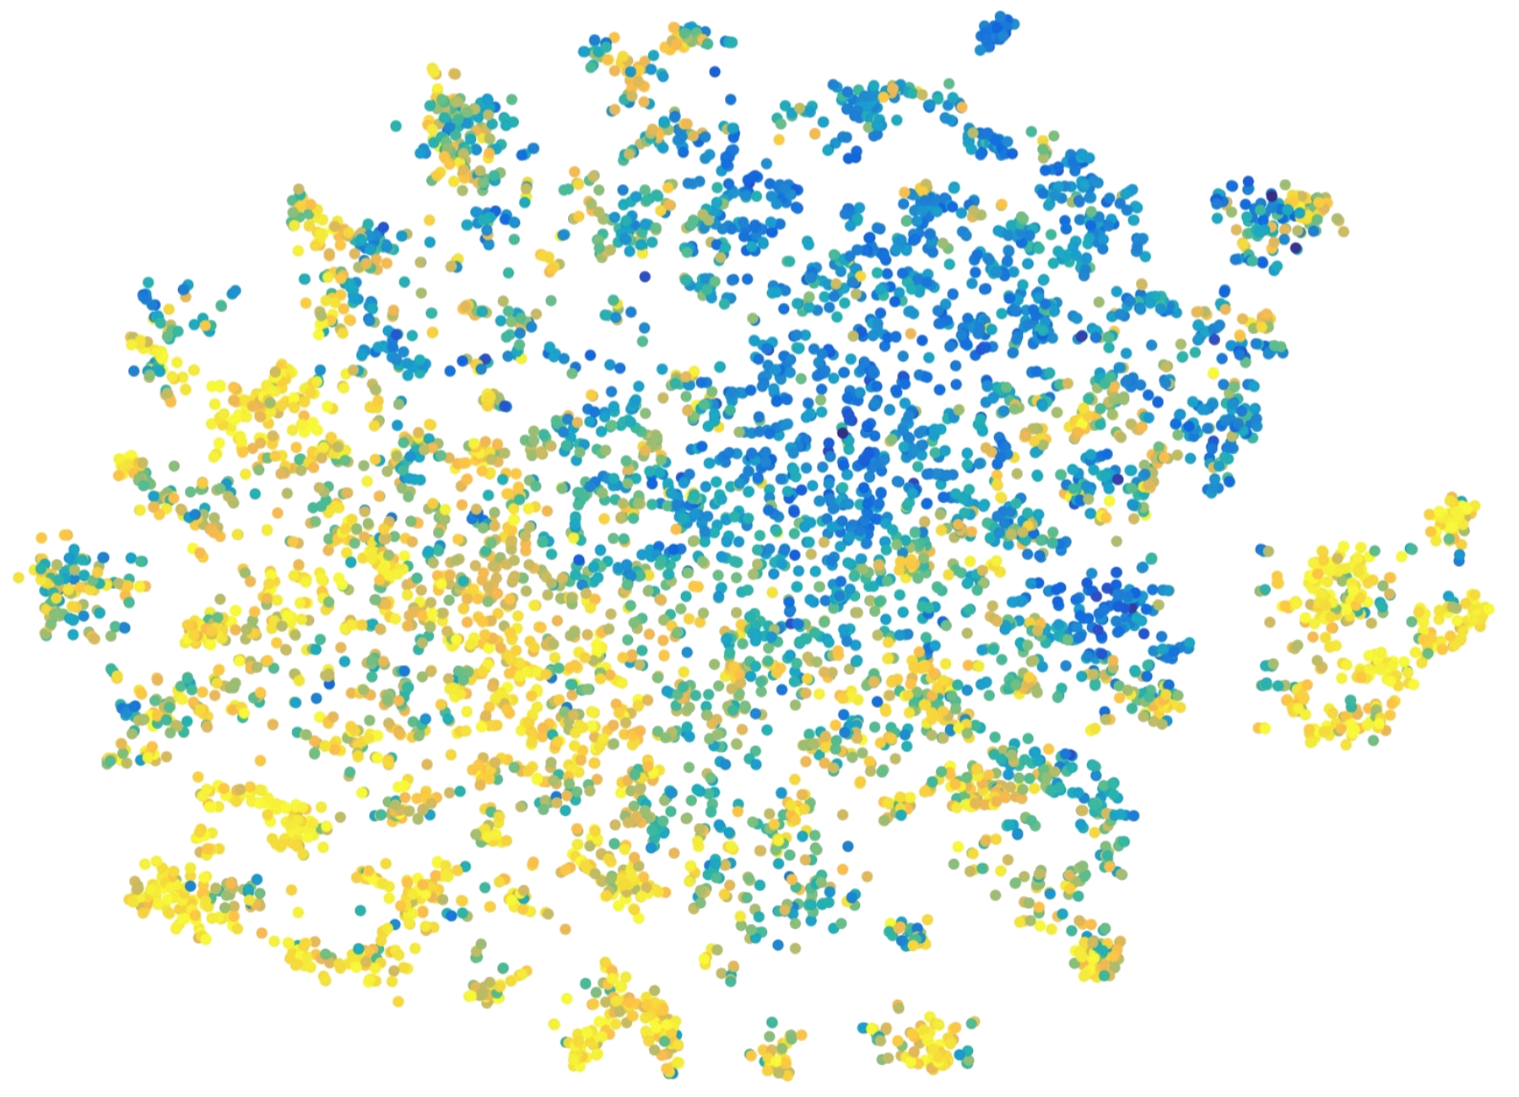
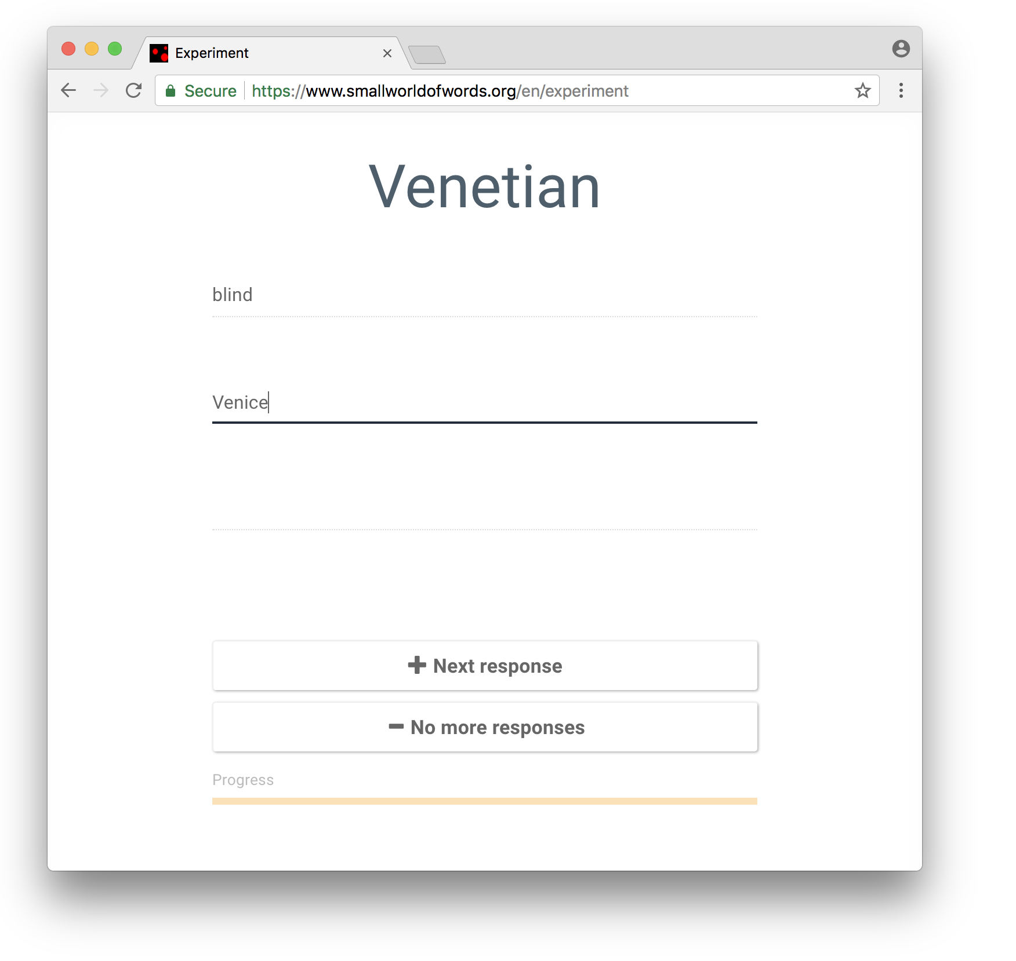
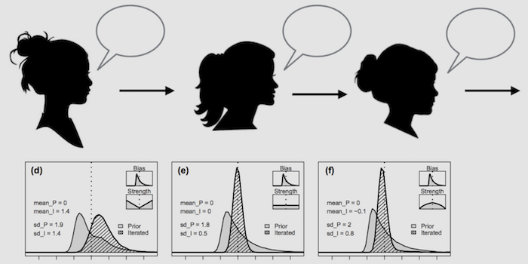
Examples
Using R to measure and analyse word association networks
Using R to visualise 200 regressions using one figure
Using R to model the effect of individual differences have on cultural evolution
Twitter

