Slide 1

What do the experts know?
A hierarchical Bayesian approach for assessing and aggregating the predictions of forensic handwriting experts
Dani Navarro, Kristy Martire, Kaye Ballantyne, Bethany Growns

Slide 2
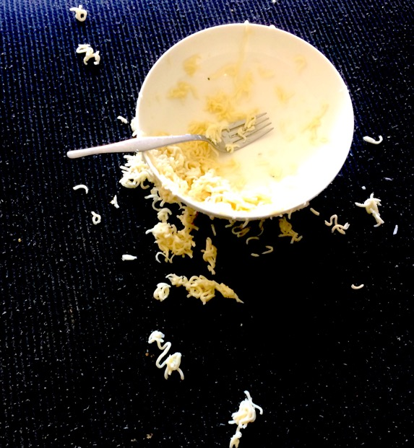
A crime has been committed

Slide 3
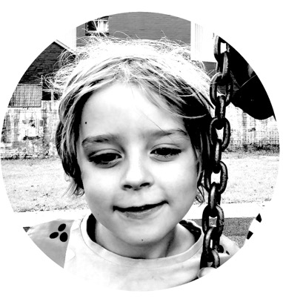
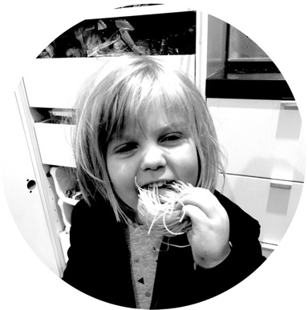
A crime has been committed
We have suspects

Slide 4
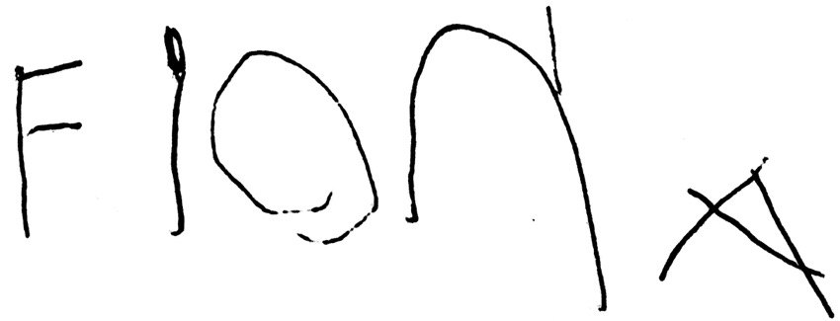
A note is found near the crime scene

Slide 5
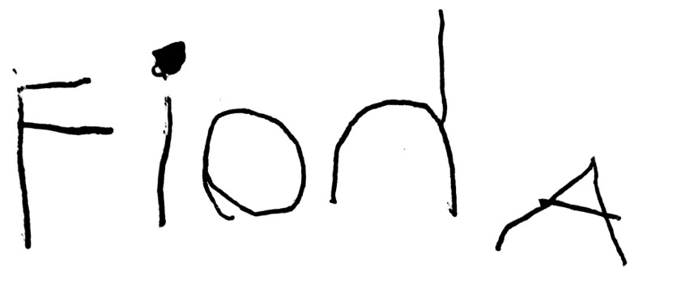
The police have a sample of handwriting from one of our suspects

Slide 6



The process problem: were these written in the same way?
Is the author trying to “disguise” their handwriting or mimic someone else’s… or is it a “natural” process?

Slide 7
The authorship problem: were these written by same person?
Can you tell the difference between a forgery, a genuine sample, and someone trying to disguise their identity?

Slide 8
The feature match problem: what are the relevant features, and do the samples match?

Slide 9
The feature probability problem: how likely is it that a random sample of handwriting has this feature?

Slide 10

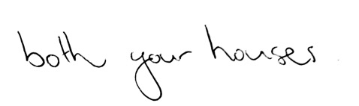
On the feature probability question
What have the document examiners (implicitly) learned about the statistics of the environment?
How common is it to see a backwards “n”?
How common is it to see backwards sloping letters?

Slide 11


Probability judgment is linked* to authorship judgment: the evidentiary value of a matching feature depends on how commonplace it is…
* Importantly though, they’re not the same thing

Slide 12
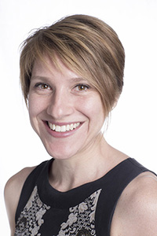
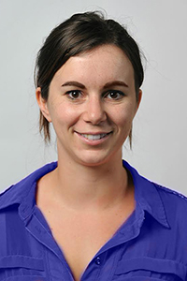
An opportunistic data collection exercise
Kristy Martire
Bethany Growns

Slide 13
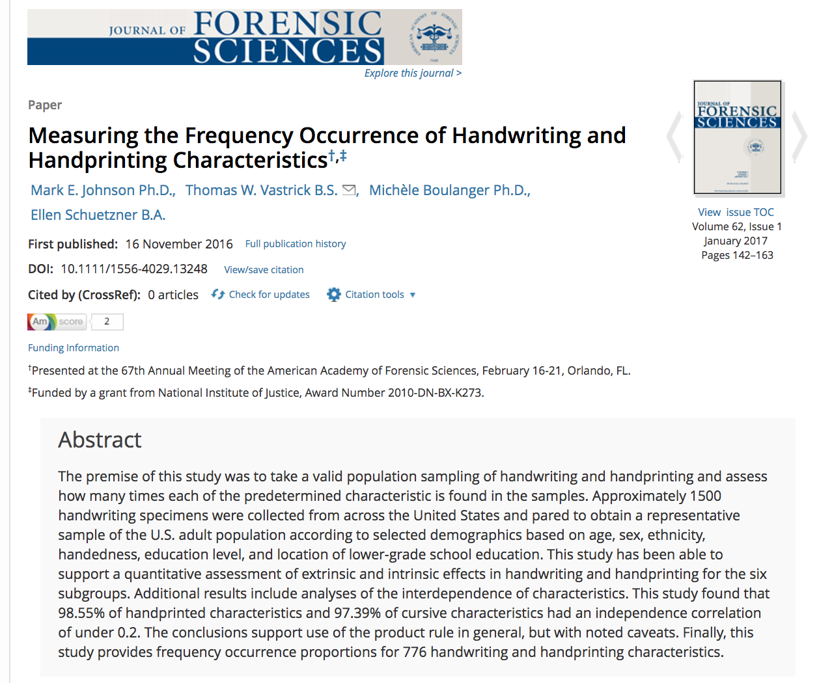
Johnson et al (2016)

Slide 14
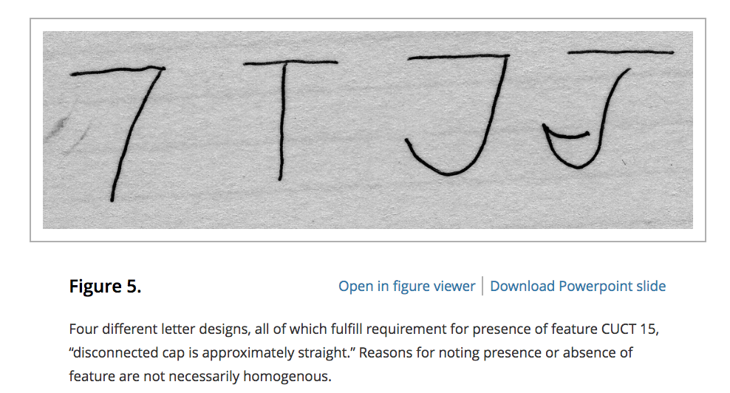
Johnson et al (2016)

Slide 15
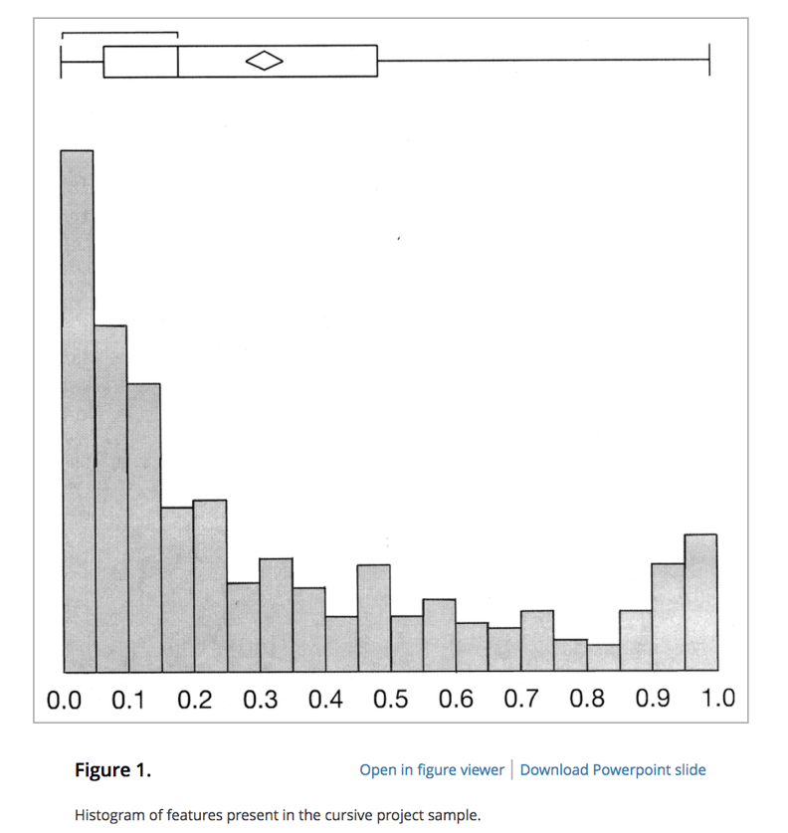
So… how much intuitive knowledge do document examiners have about feature frequency?
Handwriting features vary a lot in terms of their prevalence
Johnson et al (2016)

Slide 16
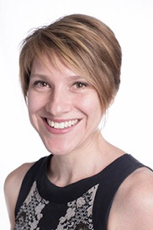
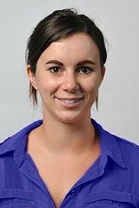
We’ve seen this data before the public release, so we can use it to design a study… if we’re quick about it
???

Slide 17
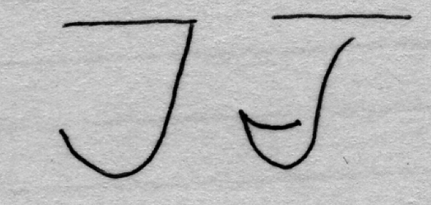
What is the frequency of this feature in US handwriting?
Blah blah description blah
60 judgments per person
Items varied in true frequency

Slide 18
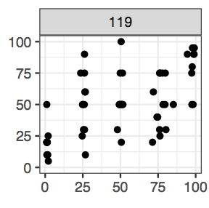
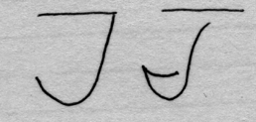
For example, one person might give responses like this…
Judged frequency
True frequency

Slide 19


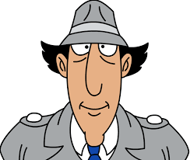
US
Non US
Have some real world experience of the relevant environmental statistics?
Experience of the “handwriting world” is likely to reflect different statistics?
Experts
Have professional experience testifying about handwriting
n = 8
n = 10
Novices
n = 36
n = 41
No such experience

Slide 20
The data & some
confirmatory analyses

Slide 21
Some novices…

Slide 22
All the experts

Slide 23
… minus one

Slide 26
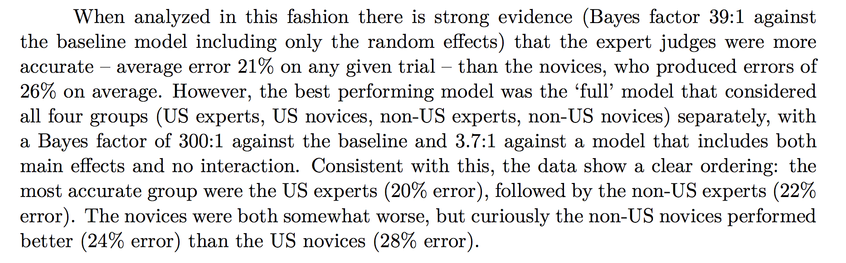


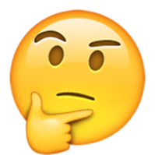
>
>
>

Slide 27
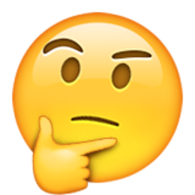
Okay, so expertise buys you something in this task… but what????

Slide 28
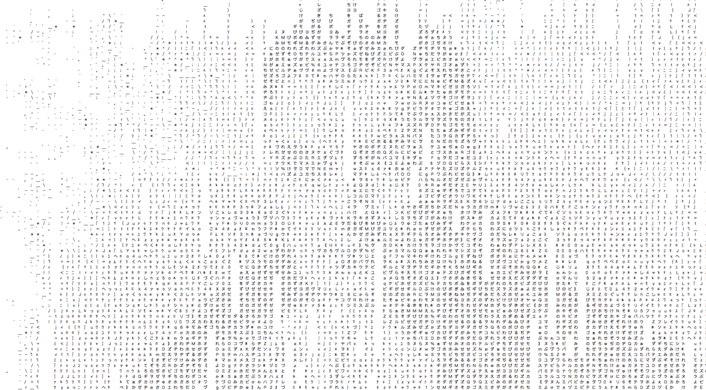
Exploratory data analysis using a hierarchical Bayesian model of probability judgment

Slide 29






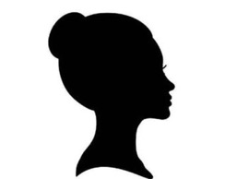
Shared “cultural knowledge” about handwriting features
0
1

Slide 30
Idiosyncratic “calibration” function mapping beliefs to stated probabilities
1
1
0
1
1
0

Slide 31
Idiosyncratic distortion (or noise) in the stated beliefs reflecting the level of precision with which each person can access the cultural knowledge
1
1
0
1
1
0

Slide 32
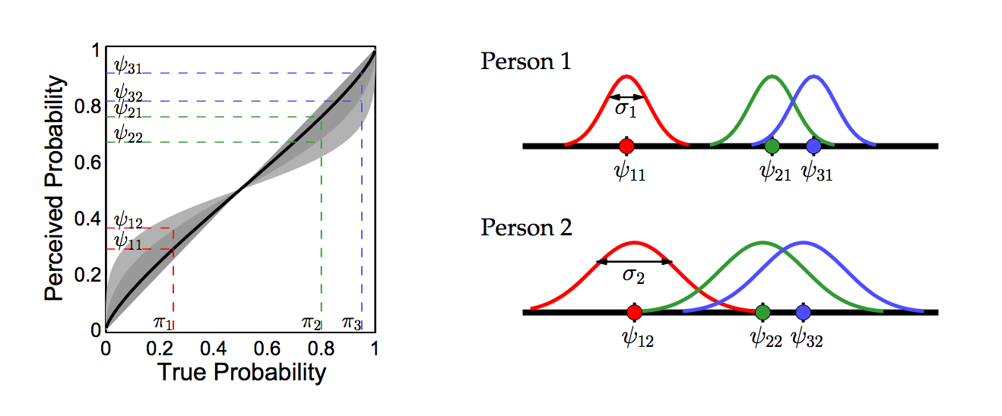
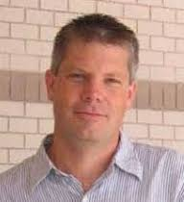
Calibration
Precision
… it’s essentially a version of the Bayesian Thurstonian model with a more flexible class of calibration models
Lee & Danileiko (2014)

Slide 33
So what do we observe?

Slide 34
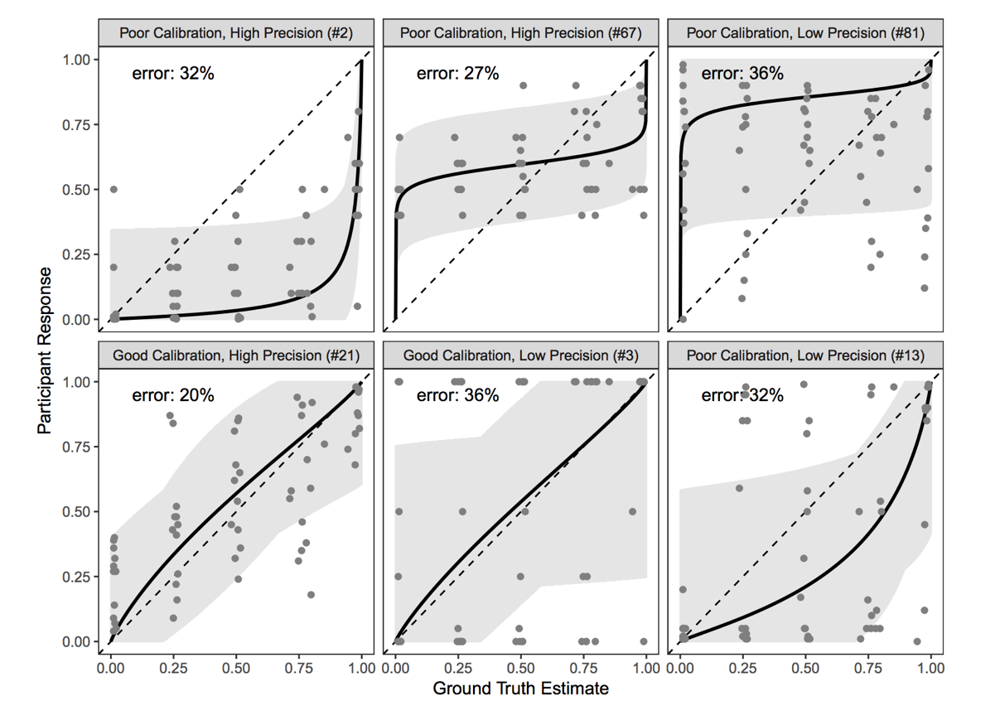
Analysis at the level of error rate masks a lot of individual variability

Slide 35
Sometimes there are tradeoffs
These people have calibration curves with the same curvilinear shape, and same overall error rate
more bias, less noise
less bias, more noise

Slide 36
Sometimes one person is just better
These two have the same shape calibration function, but…
less bias, less noise
more bias, more noise

Slide 37
Two people with very low bias, but very different levels of imprecision
no bias, low(ish) noise
no bias, very large noise

Slide 38
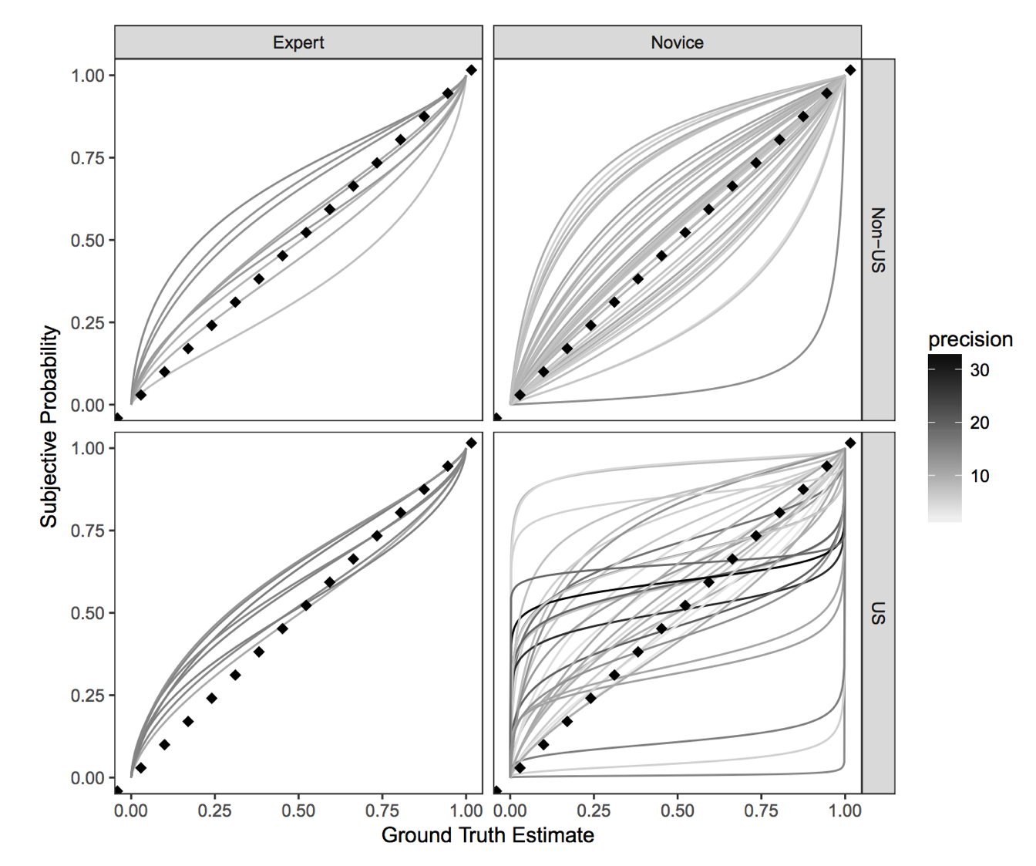

Slide 39
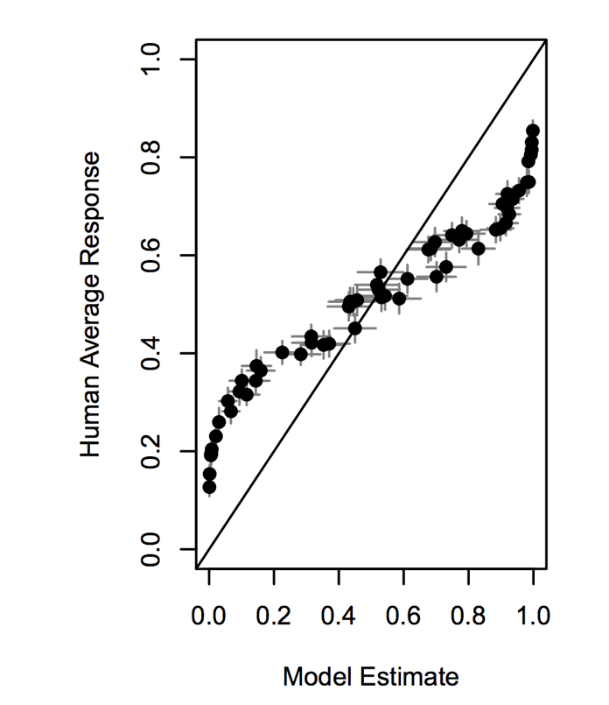

Averaging responses masks the individual differences in calibration functions!

Slide 40
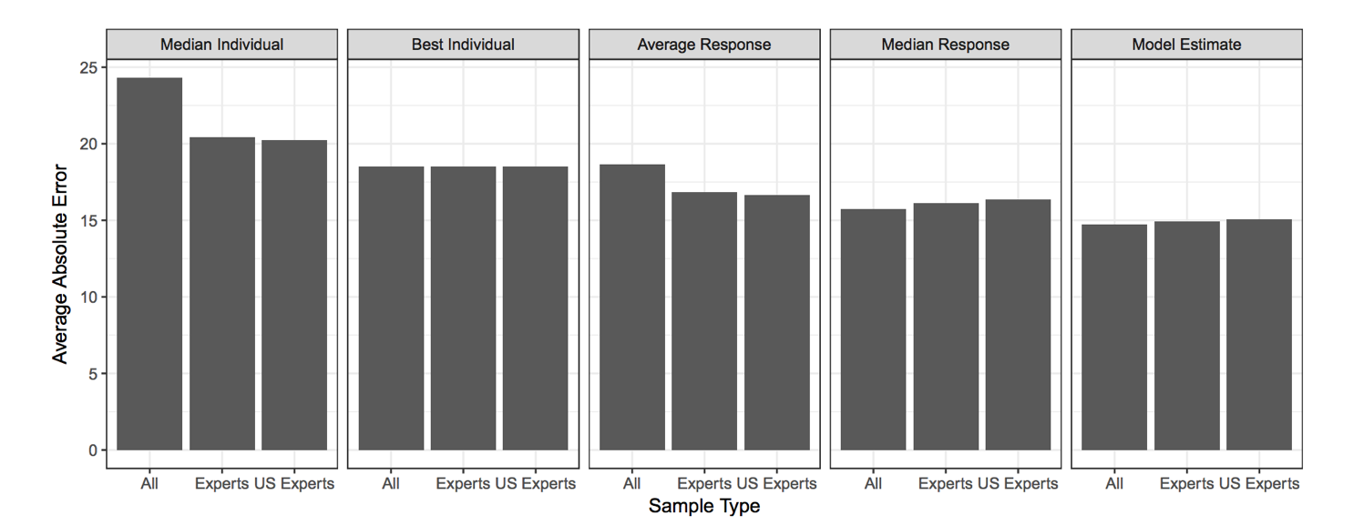
Is there a wisdom of crowds effect?

Slide 41
Not if you use the average response

Slide 42
There is if you use the median or the Thurstonian model

Slide 43
Average recovers a bit if you know who the experts are and only include them

Slide 44
Median & Thurstonian are both helped slightly by the inclusion of novices?

Slide 45
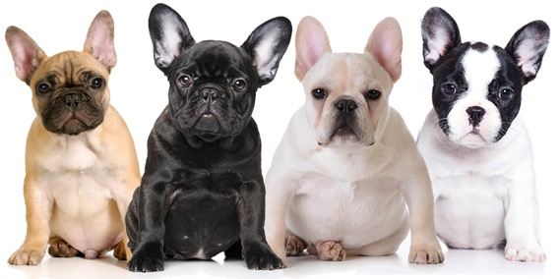
Extending the approach when ground truth is harder to establish
Kristy Martire
Kaye Ballantyne
*okay fine I couldn’t find pictures, but they both own cute puppies, so…

Slide 46
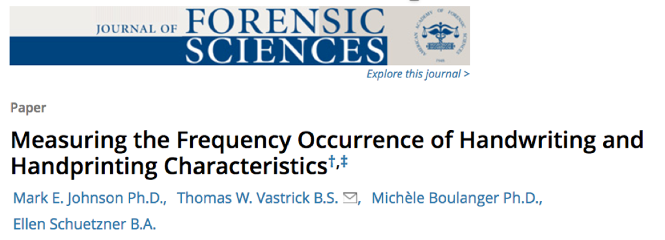
The feature probability problem allows straightforward benchmarking… get some handwriting, count the features!

Slide 47



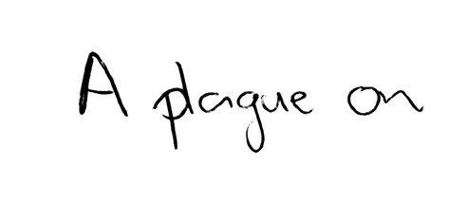
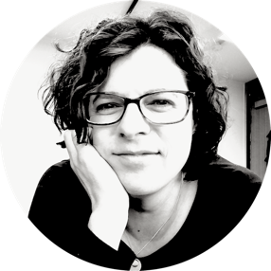
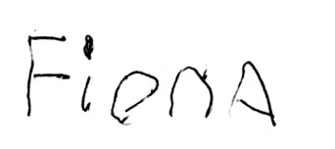
The authorship problem is trickier…
… are these equally “difficult” decisions? How would you know?
… and of course the difficulty generalises to the process problem too

Slide 48


Were these written by the same person?
(*I’m soooo oversimplifying the data collection)
Very strong support for “yes”
Qualified support for “yes”
Evidence is inconclusive
Qualified support for “no”
Very strong support for “no”

Slide 49

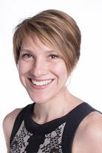
Psst… Likert scales are tricky, so don’t screw this up?
Wisdom of crowds models are tricky, so don’t screw this up?
Experts don’t grow on trees so don’t screw this up?

Slide 50
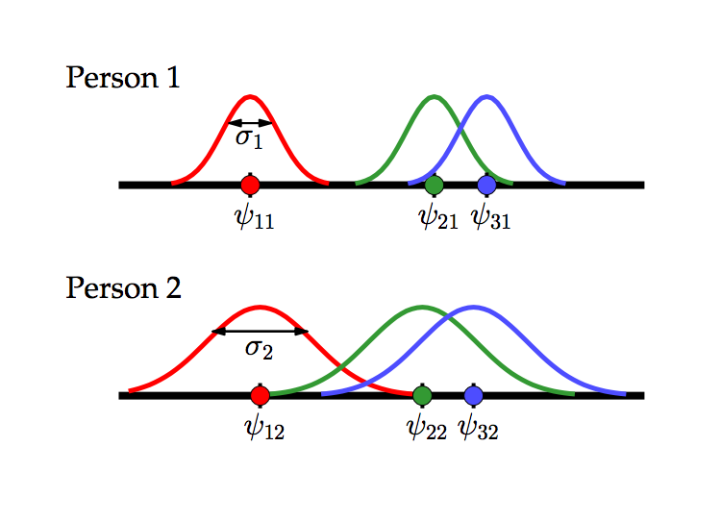



Okay, let’s assume a latent “authorness” scale for each item

Slide 51
And a latent expertise for each person

Slide 52
qual.
“no”
strong “no”
inconc.
qual.
“yes”
strong “yes”
To model Likert responding, we assume each person sets decision thresholds

Slide 53
4
5
3
2
1
4
5
3
2
1
Each person can set their own thresholds

Slide 54
The model as a whole
characteristics of item (unknown)
\
expertise of decision maker (unknown)
response strategy adopted by the decision maker (unknown)

Slide 55
The model as a whole
true “authorness” of item j
expertise level of person i
subjective impression of authorness for item j felt by person i
decision threshold set by person i for response category k
response category selected by person i when shown item j
category k
person i
item j

Slide 56


Slide 57
Are you going somewhere useful with this?
Oh, right…

Slide 58
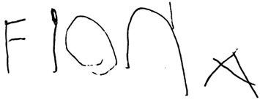



Estimates of “latent strength of evidence”
More likely to be same author
Optimal cutoff
More likely to be different author

Slide 59
It estimates the decision strategy and expertise level for each person (training tool?)

Slide 60
It looks at how experts adapt the response strategy when the data are “malicious” (lot of “inconclusives”)

Slide 61
But it also reveals how “malicious” data still manages to mess with people

Slide 62
Everyone happy now?

Slide 63
Current directions?
Extend the analysis to cover wider range of data sets

Slide 64
Current directions?
Add covariates: how does performance relate to features that experts verbally report relying on?
Slant?
Turns? Pen lifts?
Extend the analysis to cover wider range of data sets

Slide 65



Current directions?
Add covariates: how does performance relate to features that experts verbally report relying on?
Slant?
Turns? Pen lifts?
Extend the analysis to cover wider range of data sets
How effective are the visual “pepsi plot” representations as training tools (e.g., inducing criterion shift?)
“don’t change”
“call things forgeries more”
“revisit basic training?”

Slide 66
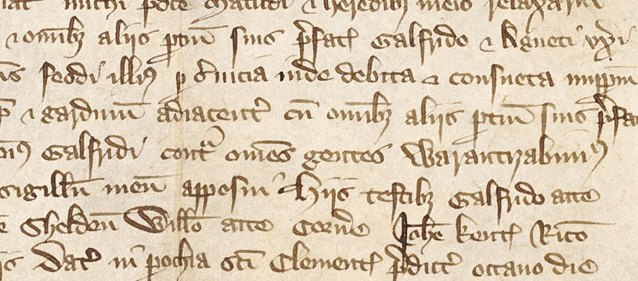
Thanks!

Slide 67
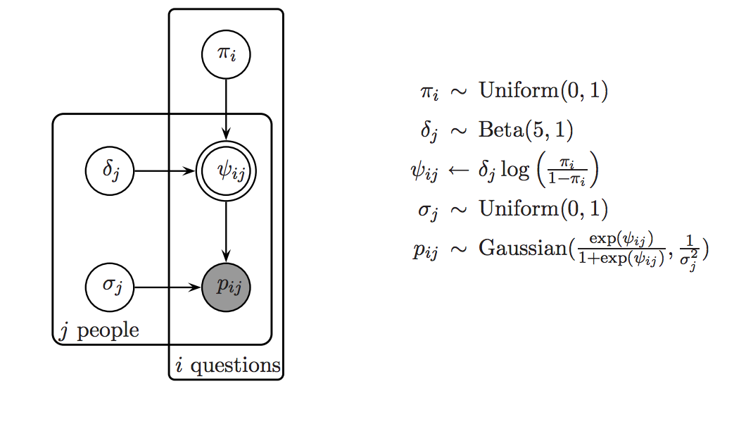

Slide 68
LOW
VARIANCE
LOW BIAS
HIGH BIAS
HIGH
VARIANCE

